Slide 1
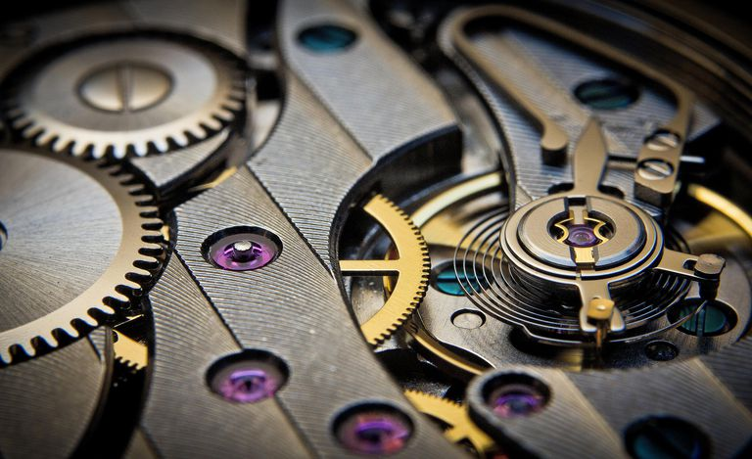
Basics of Mechanics

Slide 2
Machines and Mechanisms
A mechanism is a combination of rigid or restraining bodies so shaped and connected that they move upon each other with a definite relative motion. A simple example of this is the slider crank mechanism used in an internal combustion or reciprocating air compressor.
A machine is a mechanism or a collection of mechanisms which transmits force from the source of power to the resistance to be overcome, and thus perform a mechanical work.

Slide 3
What is Mechanics?
Mechanics is a field of science concerned with the behavior of physical bodies when subjected to forces or displacements, and the subsequent effects of the bodies on their environment.
Coming to classical mechanics we have kinematics and dynamics of motion.
Classical Mechanics
Kinematics: Here we focus on the motion of the body and not its cause.
Dynamics: Here we focus on the cause of motion

Slide 4
Force
Any interaction that when unopposed will change the motion of the object.
Torque
Torque is a measure of how much a force acting on an object causes that object to rotate.
Axis of Rotation
The straight line through all fixed points of a rotating rigid body around which all other points of the body move in circles.

Slide 5
Degrees of Freedom
Degrees of freedom/mobility of a mechanism is the number of inputs (number of independent coordinates) required to describe the configuration or position of all the links of the mechanism, with respect to the fixed link at any given instant.
Grubler’s equation: Number of degrees of freedom of a mechanism is given by
F = 3(n-1)-2l-h.
Where,
F = Degrees of freedom
n = Number of links = n₂ + n₃ +……+n_{j} , where, n₂ = number of binary links (2 nodes), n₃ = number of ternary links (3 nodes) …etc.
l = Number of lower pairs, which is obtained by counting the number of joints. If more than two links are joined together at any point, then, one additional lower pair is to be considered for every additional link.
h = Number of higher pairs

Slide 6
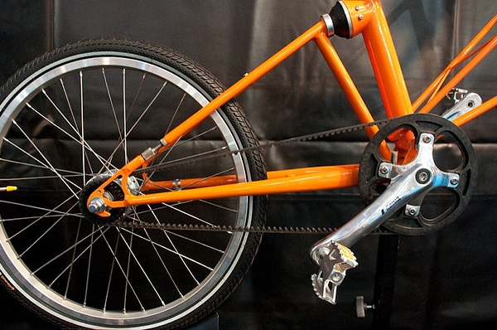
Links
Each resistant body in a machine which moves relative to another resistant body is called Kinematic link or element. A resistant body is one which does not go under deformation while transmitting the force.

Slide 7
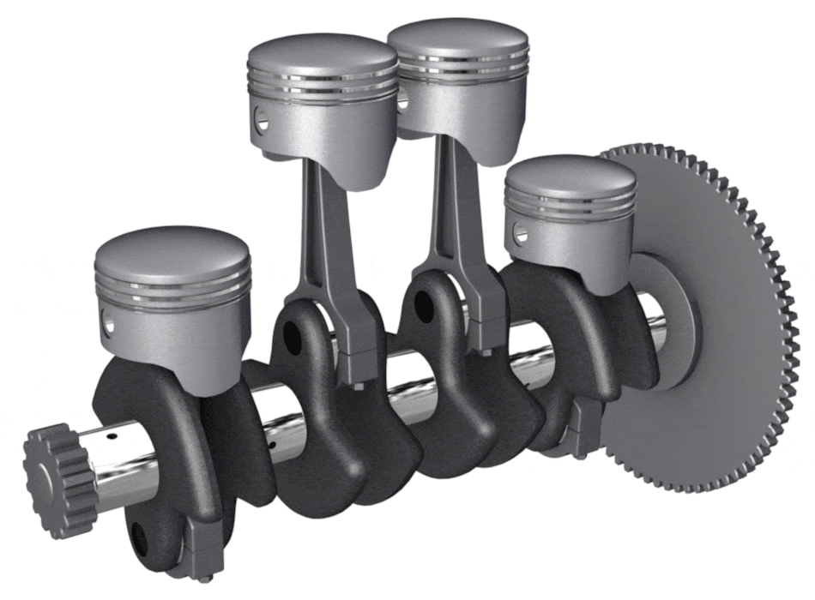
Rigid Link
In this type of link there is no deformation while transmitting the motion. Motion between the piston and crank can be considered as a rigid link.

Slide 8
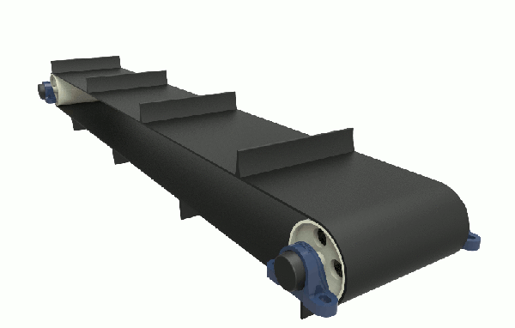
Flexible Link
In this type of link there is partial deformation while transmitting the motion. Belt drive is an example of flexible link.

Slide 9
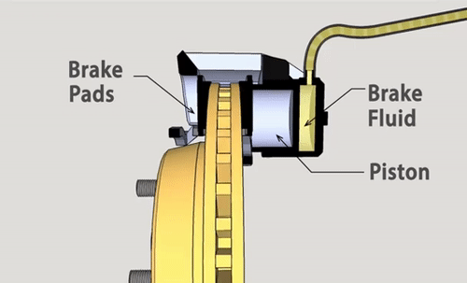
Fluid Link
In this type of link the motion is transmitted with the help of fluid pressure. Hydraulic brake is an example of fluid link

Slide 10
Joints
A joint is a connection between two or more links at their nodes, which allows motion to occur between the links. A pivot is a joint that allows rotary motion, A slider is a joint that allows linear motion.

Slide 11
Classification
Basically the Kinematic Joints are classified into two categories based on the type of contact between the two members making a joint. It can be point, line or area contact.
1. Lower pair joint.
2. Higher pair joint.
But a third category of kinematic joint can also be created which is comprised of the joints formed by combination of two or more lower and/or higher pair joints. Such joints are termed as Compound Joints.
3. Compound Joints

Slide 12
Lower Pair Joints
The two members forming a lower pair joint have area contact between the two surfaces. The contact stress is thus small for lower pair joint as compared to higher pair joints. Lower pair joints have long service life as the wear and stress is spread over larger surface area of contact and also allows for better lubrication. The degrees of freedom for a lower pair of joint is usually less as the requirement for area contact between the members constrains the geometry of the joint.

Slide 13
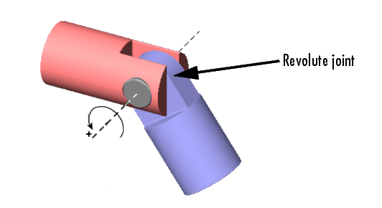
Revolute Joint
A revolute joint (also called pin joint or hinge joint) is a 1DoF kinematic pair used in mechanisms. Revolute joints provide single-axis rotation function used in many places such as door hinges, folding mechanisms, and other uniaxial rotation devices. They do not allow translation, or sliding linear motion.

Slide 14
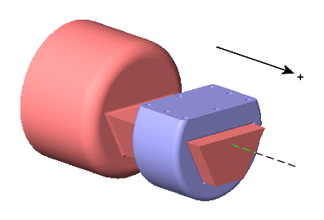
Prismatic Joint
A prismatic joint provides a linear sliding movement between two bodies, and is often called a slider, as in the slider-crank linkage. A prismatic pair is also called as sliding pair. A prismatic joint can be formed with a polygonal cross-section to resist rotation.
The relative position of two bodies connected by a prismatic joint is defined by the amount of linear slide of one relative to the other one. This one parameter movement identifies this joint as a 1DoF kinematic pair.
Prismatic joints provide single-axis sliding often found in hydraulic and pneumatic cylinders

Slide 15
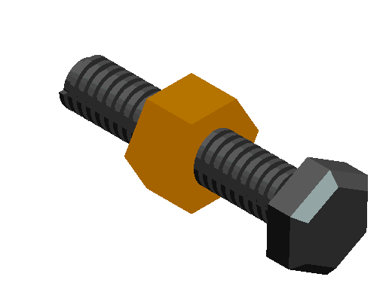
Screw / Helical Joint
A screw joint or helical joint is a 1DoF kinematic pair used in mechanisms. Screw joints provide single-axis translation by utilizing the threads of the threaded rod to provide such translation. This type of joint is used primarily on most types of linear actuators and certain types of Cartesian robots.
A Screw joint is sometimes considered as a separate type but it is actually a variation of bolted joint. The difference is that a screw is used rather that bolt, thus requiring an internal thread in one of the jointed parts. This can save space, however, continuous reuse of the thread would probably damage the coils, making the whole part unsuitable

Slide 16
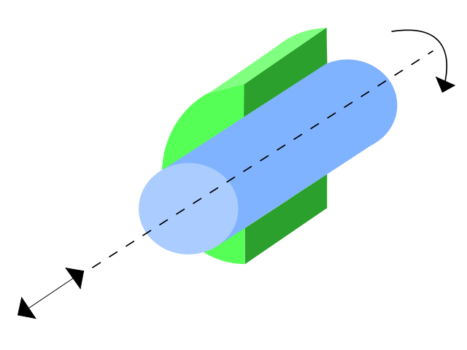
Cylindrical Joint
A cylindrical joint is a 2DoF kinematic pair used in mechanisms. Cylindrical joints provide single-axis sliding function as well as a single axis rotation, providing a way for two rigid bodies to translate and rotate freely. This can be pictured by an unsecured axle mounted on a chassis, as it may freely rotate and translate

Slide 17
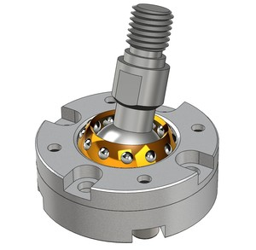
Spherical Joint
A spherical / ball joint is a 3DoF kinematic pair used in mechanisms. This joint is used for allowing free rotation in two planes at the same time while preventing translation in any direction, including rotating in those planes.

Slide 18
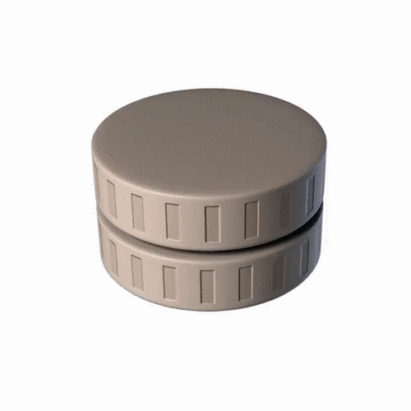
Plane Joint
A Planar Joint is a 3DoF kinematic pair.
This joint allows only gliding movement.
Plane joints permit sliding movements in the plane of articular surfaces.

Slide 19
Higher Pair Joints
The contact between the two members of higher pair has point or line geometry. The contact stress for a higher pair joint is large because of very small contact area. If there is pure rolling contact between the members then at any point of time the contact point or line is at rest. There is no relative sliding between the contact surfaces and thus friction and wear will be negligible. The degrees of freedom for a higher pair of joint can be high as the point or line contact allows for less constrained motion of members.

Slide 20
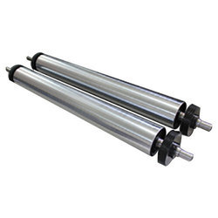
Cylindrical Roller
A Cylindrical roller is a 1DoF kinematic pair.
If a body is rolling on a plane with slipping, then its degree of freedom is 2: one for rotation about the body's axis and one for translation of its center of gravity in forward and backward direction. If there is no slipping, the translation can be calculated from the rotation and the radius of the block. Thus the degree of freedom is degenerated to 1.

Slide 21
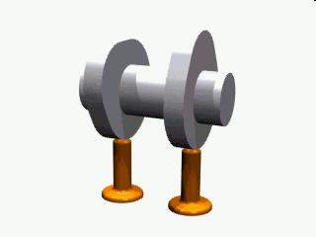
Cam Pair
A cam is a rotating or sliding piece in a mechanical linkage with 1DoF used especially in transforming rotary motion into linear motion. It is often a part of a rotating wheel (e.g. an eccentric wheel) or shaft (e.g. a cylinder with an irregular shape) that strikes a lever at one or more points on its circular path. The cam can be a simple tooth, as is used to deliver pulses of power to a steam hammer, for example, or an eccentric disc or other shape that produces a smooth reciprocating (back and forth) motion in the follower, which is a lever making contact with the cam.

Slide 22
Compound Joints
Lower pair and/or higher pair joints are combined as per the design requirement to obtain compound joints. Compound joints composed of higher pair joints can be kinematically equivalent to lower pair joints or vice verse. By such combinations desirable features from the combining joints are retained to obtain robust joints.

Slide 23
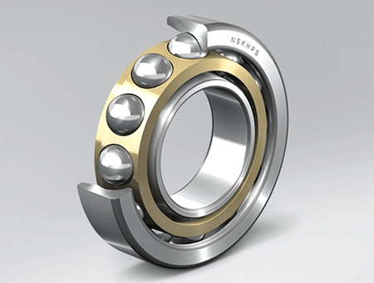
Ball or Roller Bearings
The actual members in contact are balls or rollers with the inner and outer race. These are rolling contact which is a higher pair. But the overall joint has the motion geometry of revolute joint, a lower pair. A ball bearing has low friction properties of rolling contacts and higher load capacity of revolute joints. Ball or Roller Bearings are kinematically equivalent to simple revolute joint.

Slide 24
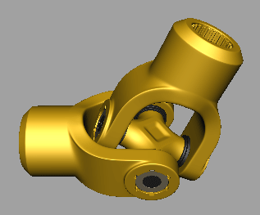
Universal of Hooke Joint
It is a combination of revolute joints and has two degrees of freedom.
A universal joint (universal coupling, U-joint, Cardan joint, or Hooke's joint) is a joint or coupling connecting rigid rods whose axes are inclined to each other, and is commonly used in shafts that transmit rotary motion. It consists of a pair of hinges located close together, oriented at 90° to each other, connected by a cross shaft.

Slide 25
Forward Kinematics
Forward kinematics refers to the use of the kinematic equations of a robot to compute the position of the end-effector from specified values for the joint parameters. The kinematics equations of the robot are used in robotics, computer games, and animation.

Slide 26
Inverse Kinematics
In robotics, inverse kinematics makes use of the kinematics equations to determine the joint parameters that provide a desired position for each of the robot's end-effectors. Specification of the movement of a robot so that its end-effectors achieve the desired tasks is known as motion planning.

